Slide 1

AsTROS

Slide 2
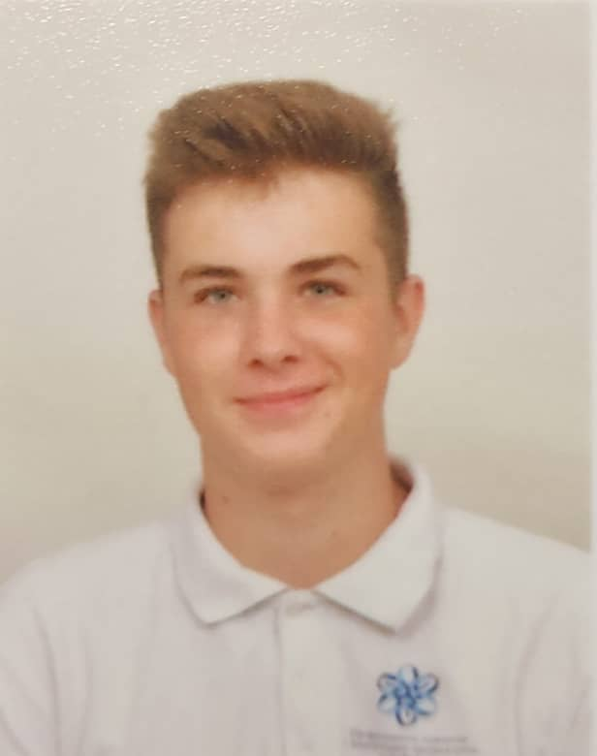
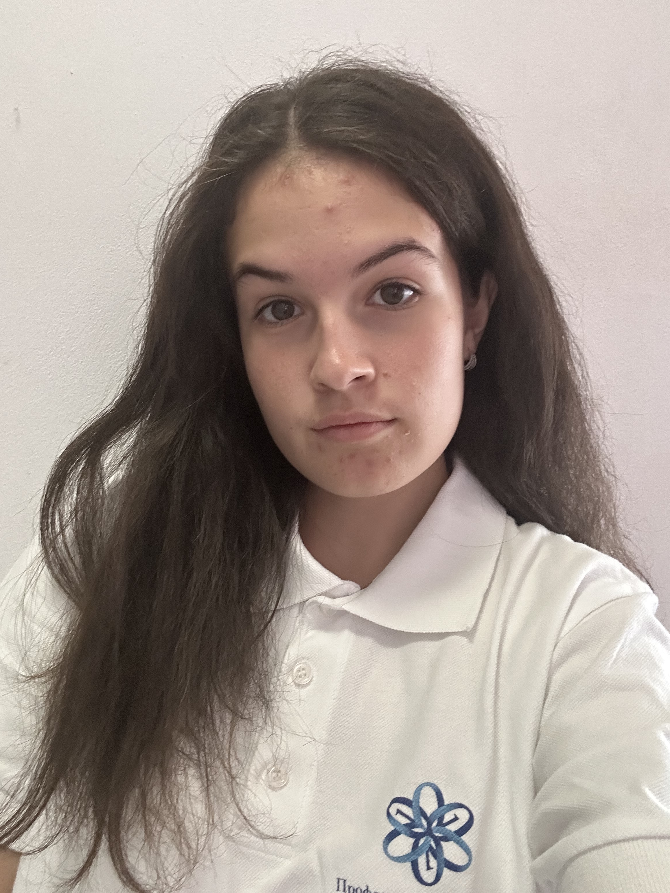
OUR TEAM
Teodora Skulieva
Back-end developer
Hristo Rusev
Scrum Trainer
Ivan Mihail Snimka
Zlatko Snimka
Ivan-Mihail Ivanov
Back-end Developer
Zlatin Lazarov
Back-end developer

Slide 3
Stages of creation

Slide 4









Technologies

Slide 5
Let’s get to the application

